Slide 1
IDEA Funding - Part B
Dan Rahm, Director of Student Services

Slide 2
What is the Individuals with Disabilities Education Act (IDEA)?
IDEA ensures that students with disabilities are provided with Free Appropriate Public Education that is tailored to their individual needs. The purpose of this legislation is to provide children with disabilities the same opportunity for education as those students who do not have a disability.
All states making application for funds under Part B of the Individuals with Disabilities Education Act (IDEA) are required to make available for public review and comment how funds are used.

Slide 3
What is Part B of IDEA?
I.D.E.A. governs how states and public agencies provide early intervention, special education and related services. Children and youth (ages 3 -21) receive special educations and related services under I.D.E.A. Part B.

Slide 4
What can special education funds be used for?
Excess Costs
SPED Teachers
Related Service Providers
Materials for SWD
Supplies for SWD

Slide 5
2023/2024 Part B Funding
Part B Funding 2023/2024 - $259,836.23

Slide 6
2023/2024 Part B Spending
Teacher Salaries - $194,142.89
Additional Services & Supplies - $65,693.34
Part B Spending = $259,836.23
+Maintenance of Effort - $2,263,854.54
Total SPED Spending = $2,180,341.12

Slide 7
Teacher Salaries
from IDEA funds
Salaries - $194,142.89
Benefits - $25,909.77
Total = $220,052.66

Slide 8
Additional Services and Supplies
Support Services - $27,859.00
Benefits - $5,100.83
Supplies & Equipment - $6,823.74
(Including talkers, sensory items, earbuds, iPads, etc.)
Total = $39,783.57

Slide 9
Maintenance of Effort
General Fund expenses for Special Education Students includes out of district placements, preschool costs, English Learner Students and Crisis Prevention Intervention.
Total = $1,920,504.58

Slide 10
Summary
IDEA Part B provides children and youth (ages 3 -21) with special education and related services.
Wellington received $259,836.23 in funding for the 2023/2024 school year.
Total spending for 2023/2024 amounted to $2,180,341.12.

Slide 11
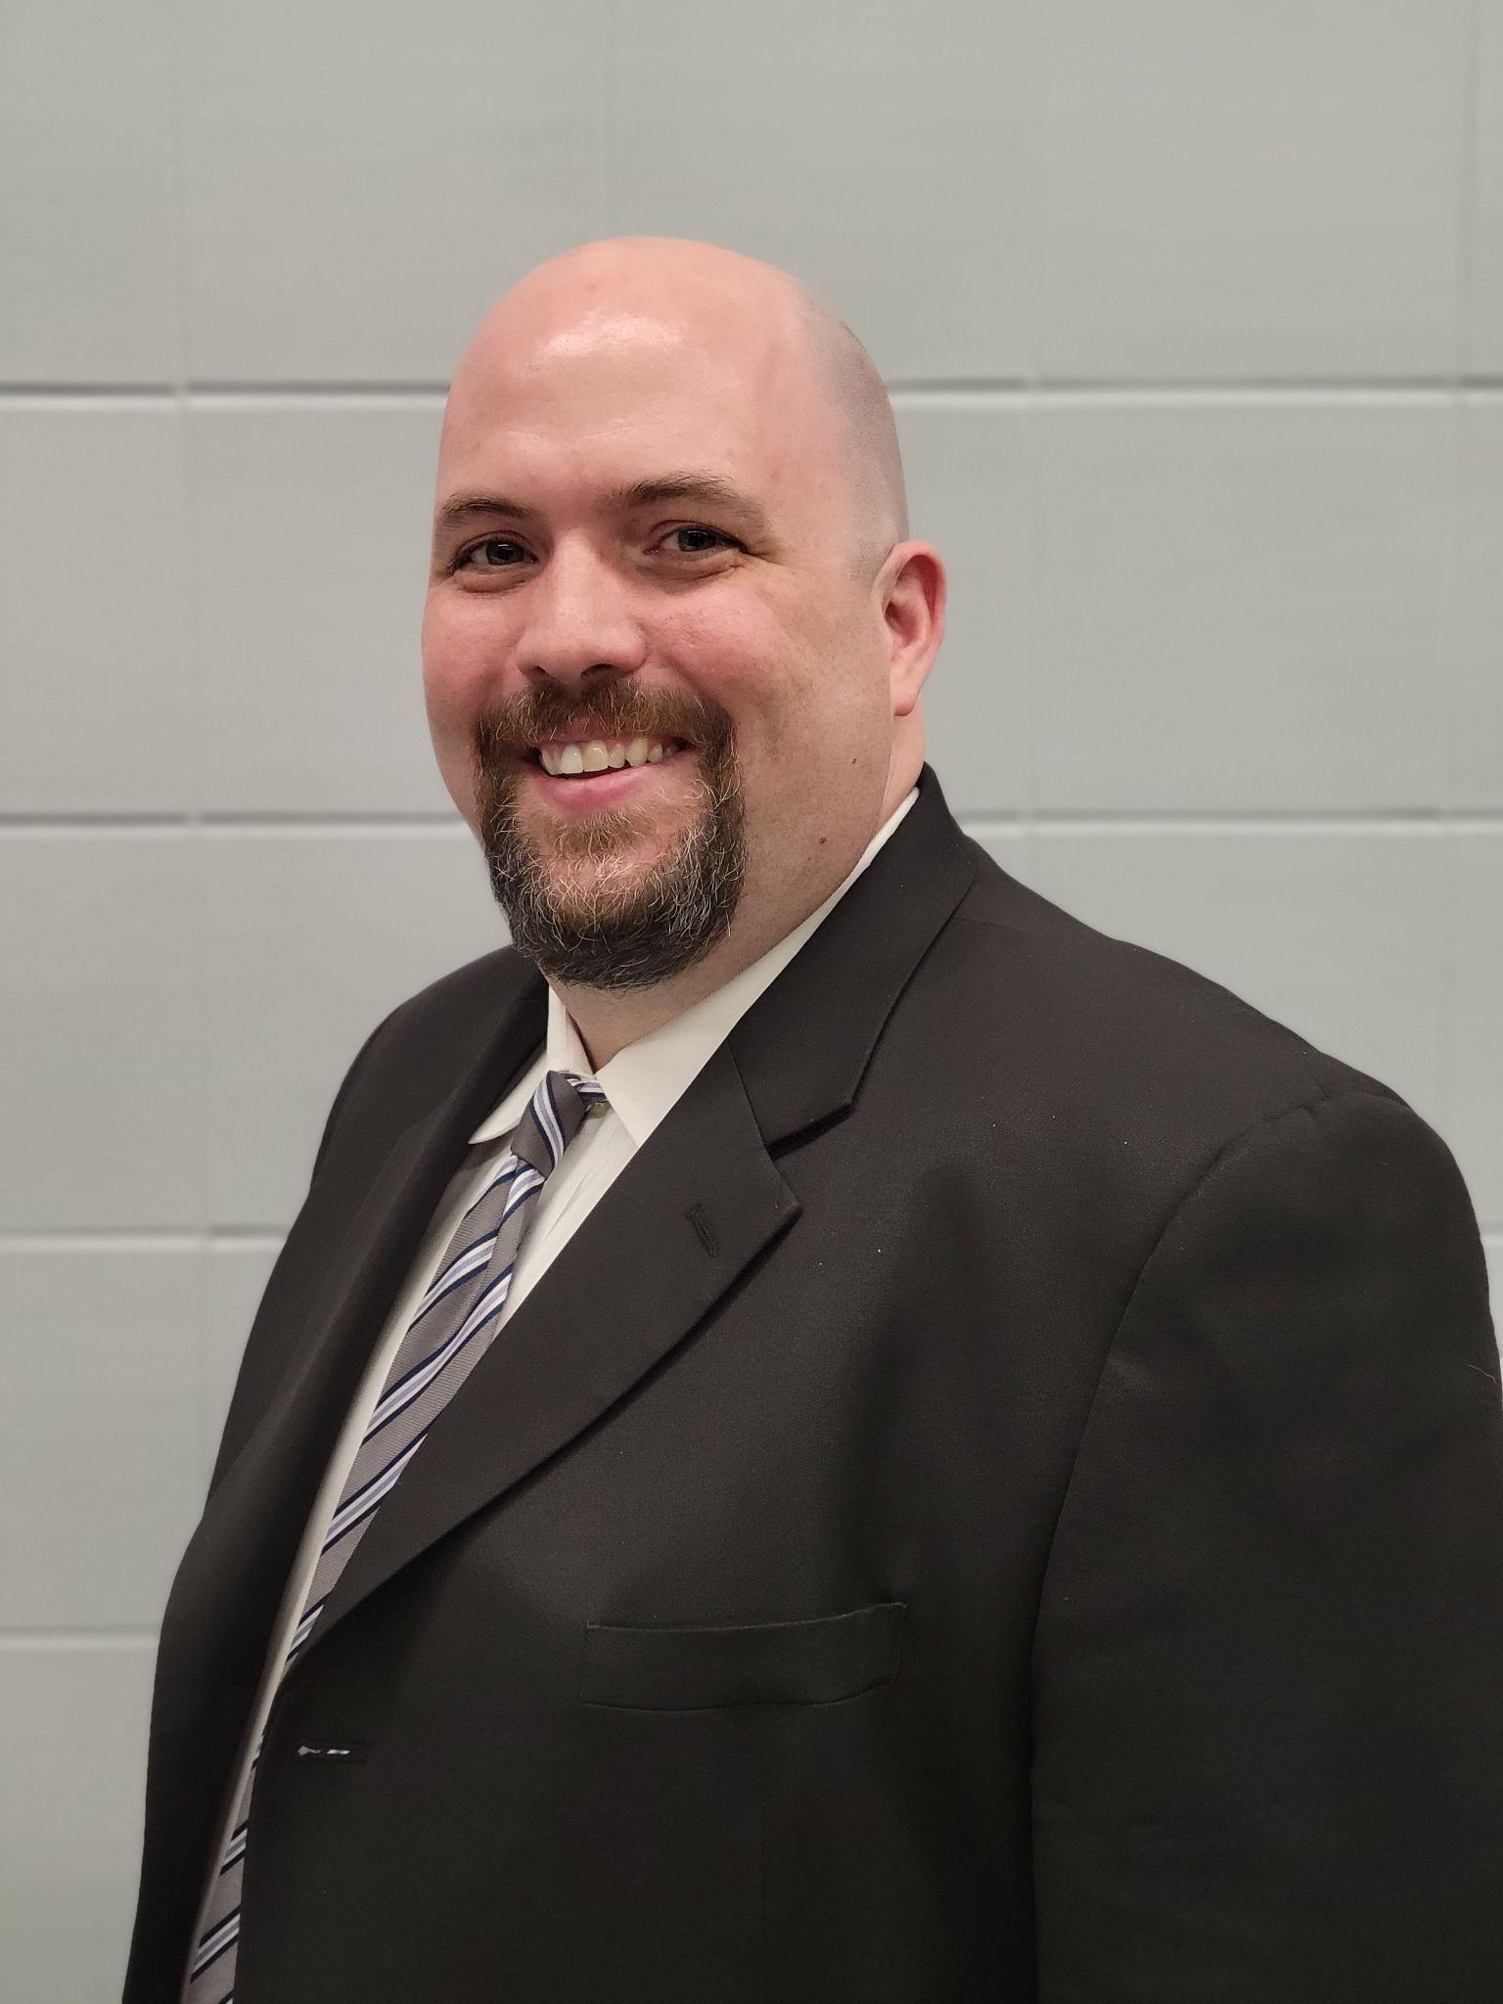
For more information, contact:
Wellington Exempted Village Schools
Director of Student Services
Dan Rahm
440-647-7907
drahm@wellingtonvillageschools.org

